Slide 1
C Programming Ch Naveen Kumar

Slide 2

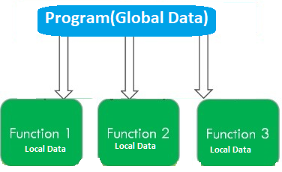

Introduction C Programming
C is a , general purpose, Procedure-Oriented Programming(POP) language.
Most widely used programming Language to develop System software such as operating systems, device drivers, protocol stacks etc.
What is POP?
In POP, a program is dividend into a set of procedures/functions to accomplish a task.
A procedure is a collection of instructions executed in sequential order.
Ex. read(),add(),display()..etc

Slide 3
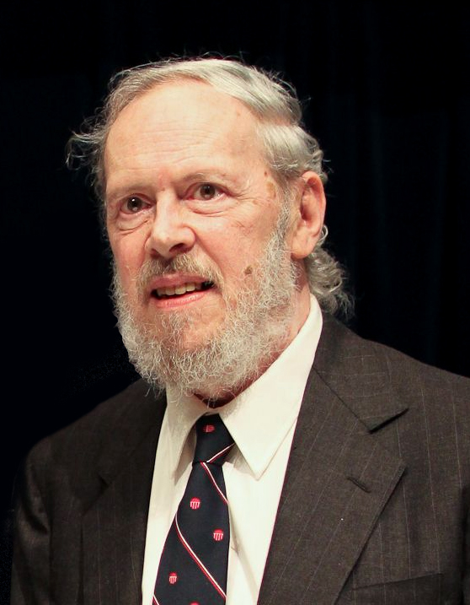
History of C
It was created in 1972 by Dennis Ritchie at the Bell Laboratories
Evolved from two previous languages – BCPL and B
Basic Combined Programming Language used for writing OS an Compilers.
B used for creating early versions of UNIX OS.
Both are type less languages.
Dennis Ritche

Slide 4
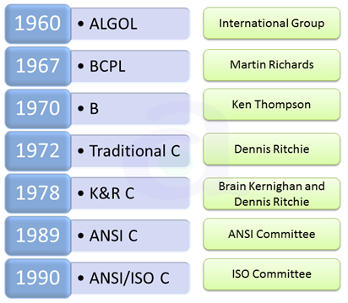
History of C

Slide 5
C Environment setup
The following two software tools available on your computer,
(a) Editor → To write the program
(b) The C Compiler -> translates High-level-code (source code) to Low level code (executable code)
Text Editors
Notepad on windows
vi or vim on UNIX or Linux
Text edit on MAC
Compilers
GNU C/C++ Compiler
Borland C
Turbo C, etc

Slide 6


Slide 8

?
Notes:
How to interact with machines?

Slide 9
100011000100101010111100

Slide 10
Hey dude!

Slide 11
HIGH LEVEL
COMPILER
LOW LEVEL

Slide 12
How human language similar to machine language?
Human
Machine
Input through ears
Input
Think
Define the logic
Prepare an answer
Process the logic
Response
Output

Slide 13
English Language
Machine Language
Vocabulary -
Keywords
Set of predefined words
Grammar -
Syntax
Way in which this words are to be arranged
Punctuations -
Set of predefined symbols
Special symbols

Slide 14
Languages used to interact with machines
Low level
Intermediate level
High level

Slide 15
Installing C Compilers
Installing on GCC on Linux
To check whether GCC is installed or not use following command
$ gcc –v
To install GCC use following commands
sudo apt-get update
sudo apt install build-essential
gcc –version
Installing on C compiler on MAC
Open a Terminal window.
Enter the command xcode-select --install

Slide 16
Installing C Compilers
We can install the C compilers on the following IDEs
IDE – Integrated Development Environment is a combination of tools like a text editor, debugger, and Compiler.
Visual Studio Code –
"Free, fully-featured IDE for students, open-source and individual developers from Microsoft
Download url: https://code.visualstudio.com/download
Add c/c++ extension (intellisense)
Dev C++ :
Dev-C++ is a free full-featured IDE for programming in C and C++ from Bloodshed Software
https://sourceforge.net/projects/orwelldevcpp/
Turbo C++
Turbo C++ is a free C/C++ compiler from Borland.
It comes with an IDE and debugger
Ellipse IDE : From IBM https://www.eclipse.org/downloads/
Code::Blocks https://www.codeblocks.org/downloads/

Slide 17
Structure of a C Program
The program written in C language follows this basic structure
1. Documentation section
2. Preprocessing or Linking section
3. Definition section
4. Global declaration section
5. main() function section
{
Declaration section
Executable section
}
6. Sub program or function section

Slide 18
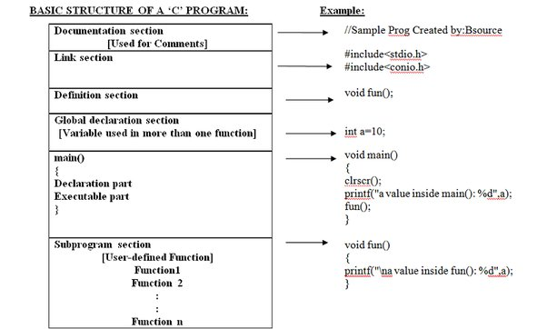
#define MAX 25

Slide 19
1. Documentation Section
Comes first and is used to document the use of logic or reasons in your program.
It can be used to write the program's objective, developer and logic details
i.e program's name, date, description, and title.
The documentation is done in C language with
//name of a program → (single line comment)
or
/* → (Multi line comment)
Overview of the code
*/

Slide 20
2.Preprocessor directive
The preprocessor section contains all the header files used in a program.
It informs the system to link the header files to the system libraries
This section tells the compiler to link the certain occurrences of keywords or functions in your program to the header files specified in this section.
e.g. #include <stdio.h>
# → Compiler Instruction
<> → Standard Directory
“ ”→ Current directory
stdio.h→ Library File

Slide 21
3. Definition section
It is used to declare some constants and assign them some value.
e.g. #define MAX 25
Here #define is a compiler directive which tells the compiler whenever MAX is found in the program replace it with 25.
4. Global Declaration Section :
Here the variables which are used through out the program (including main and other functions) are declared so as to make them global
(i.e accessible to all parts of program)
e.g. int i; (before main())

Slide 22
5. Main Function Section :
It tells the compiler where to start the execution from
main()
{
point from execution starts
}
Main function has two sections
1. declaration section : In this the variables and their data types are declared.
2. Executable section : This has the part of program which actually performs the task we need.
Main function is further categorized into local declarations, statements, and expressions

Slide 23
6. Sub program or function section
This has all the sub programs or the functions which our program needs.
The user defined functions specified the functions specified as per the requirements of the user.
For example, color(), sum(), division(), etc.
function1( ..)
{
…
…
}

Slide 24
First C Program
#include <stdio.h>
int main() {
printf("Hello World!");
return 0;
}
Save as programname.c

Slide 25
Compilation and Execution
- Preprocessing
- Compilation
- Assembly
- Linking

Slide 26
hello.c
Source Code
Preprocessor
hello.i
Expanded Source Code
Compiler
hello.s
Assembly Code
Assembler
hello.obj
Object Code
Native OS
calls
Linker
hello.exe
Executable Code

